Slide 1

VLSI Laboratory
EEE 412 / CSE 460
VLSI Lab – 08 MULTIPLEXER.
Department of Electrical & Electronic Engineering
BRAC University

Slide 2

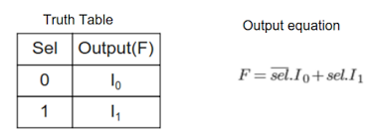
2x1 MUX

Slide 3
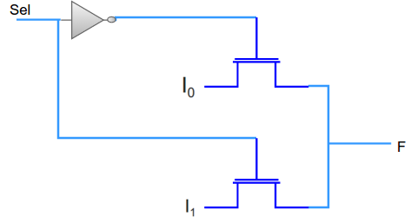
2x1 MUX

Slide 4
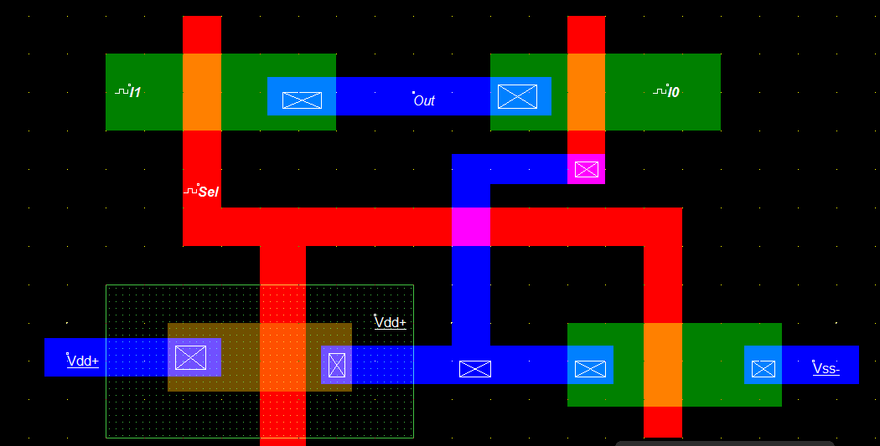
2x1 MUX

Slide 5
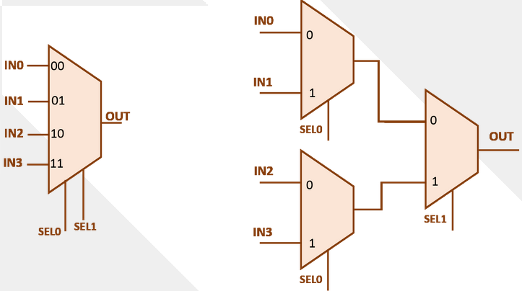
4x1 MUX

Slide 6
4x1 MUX

